Slide 1
Hand Gesture Recognition
Team name: ECE4380Group project

Slide 2
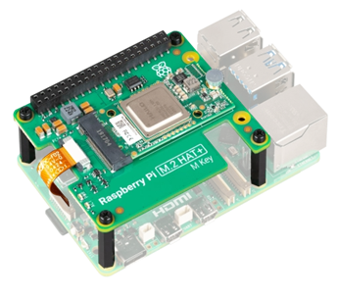
Project Overview
Using the Raspberry Pi AI Kit to identify gestures
Open Palm
Fist
Point
Thumbs up
No Gesture
Gestures are printed when detected and measured for response time
Could enable touch-free controlling for devices

Slide 3
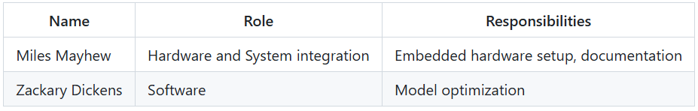
Team Member Roles

Slide 4
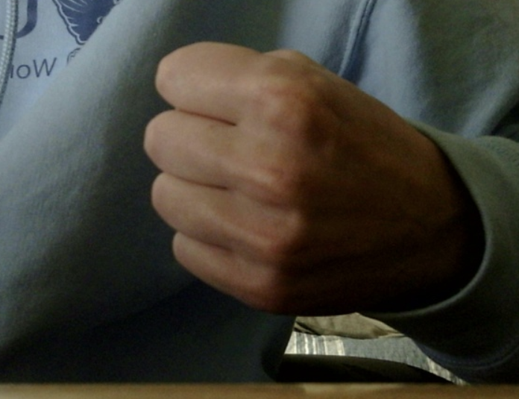
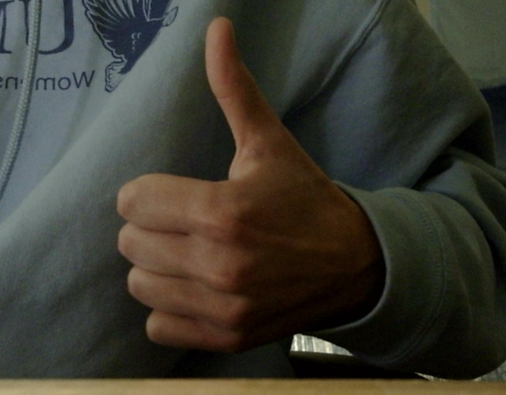
Data Collection
We took our own pictures using the USB camera
300 training images
50 test images
50 validation images
Like Gesture
Fist Gesture

Slide 5
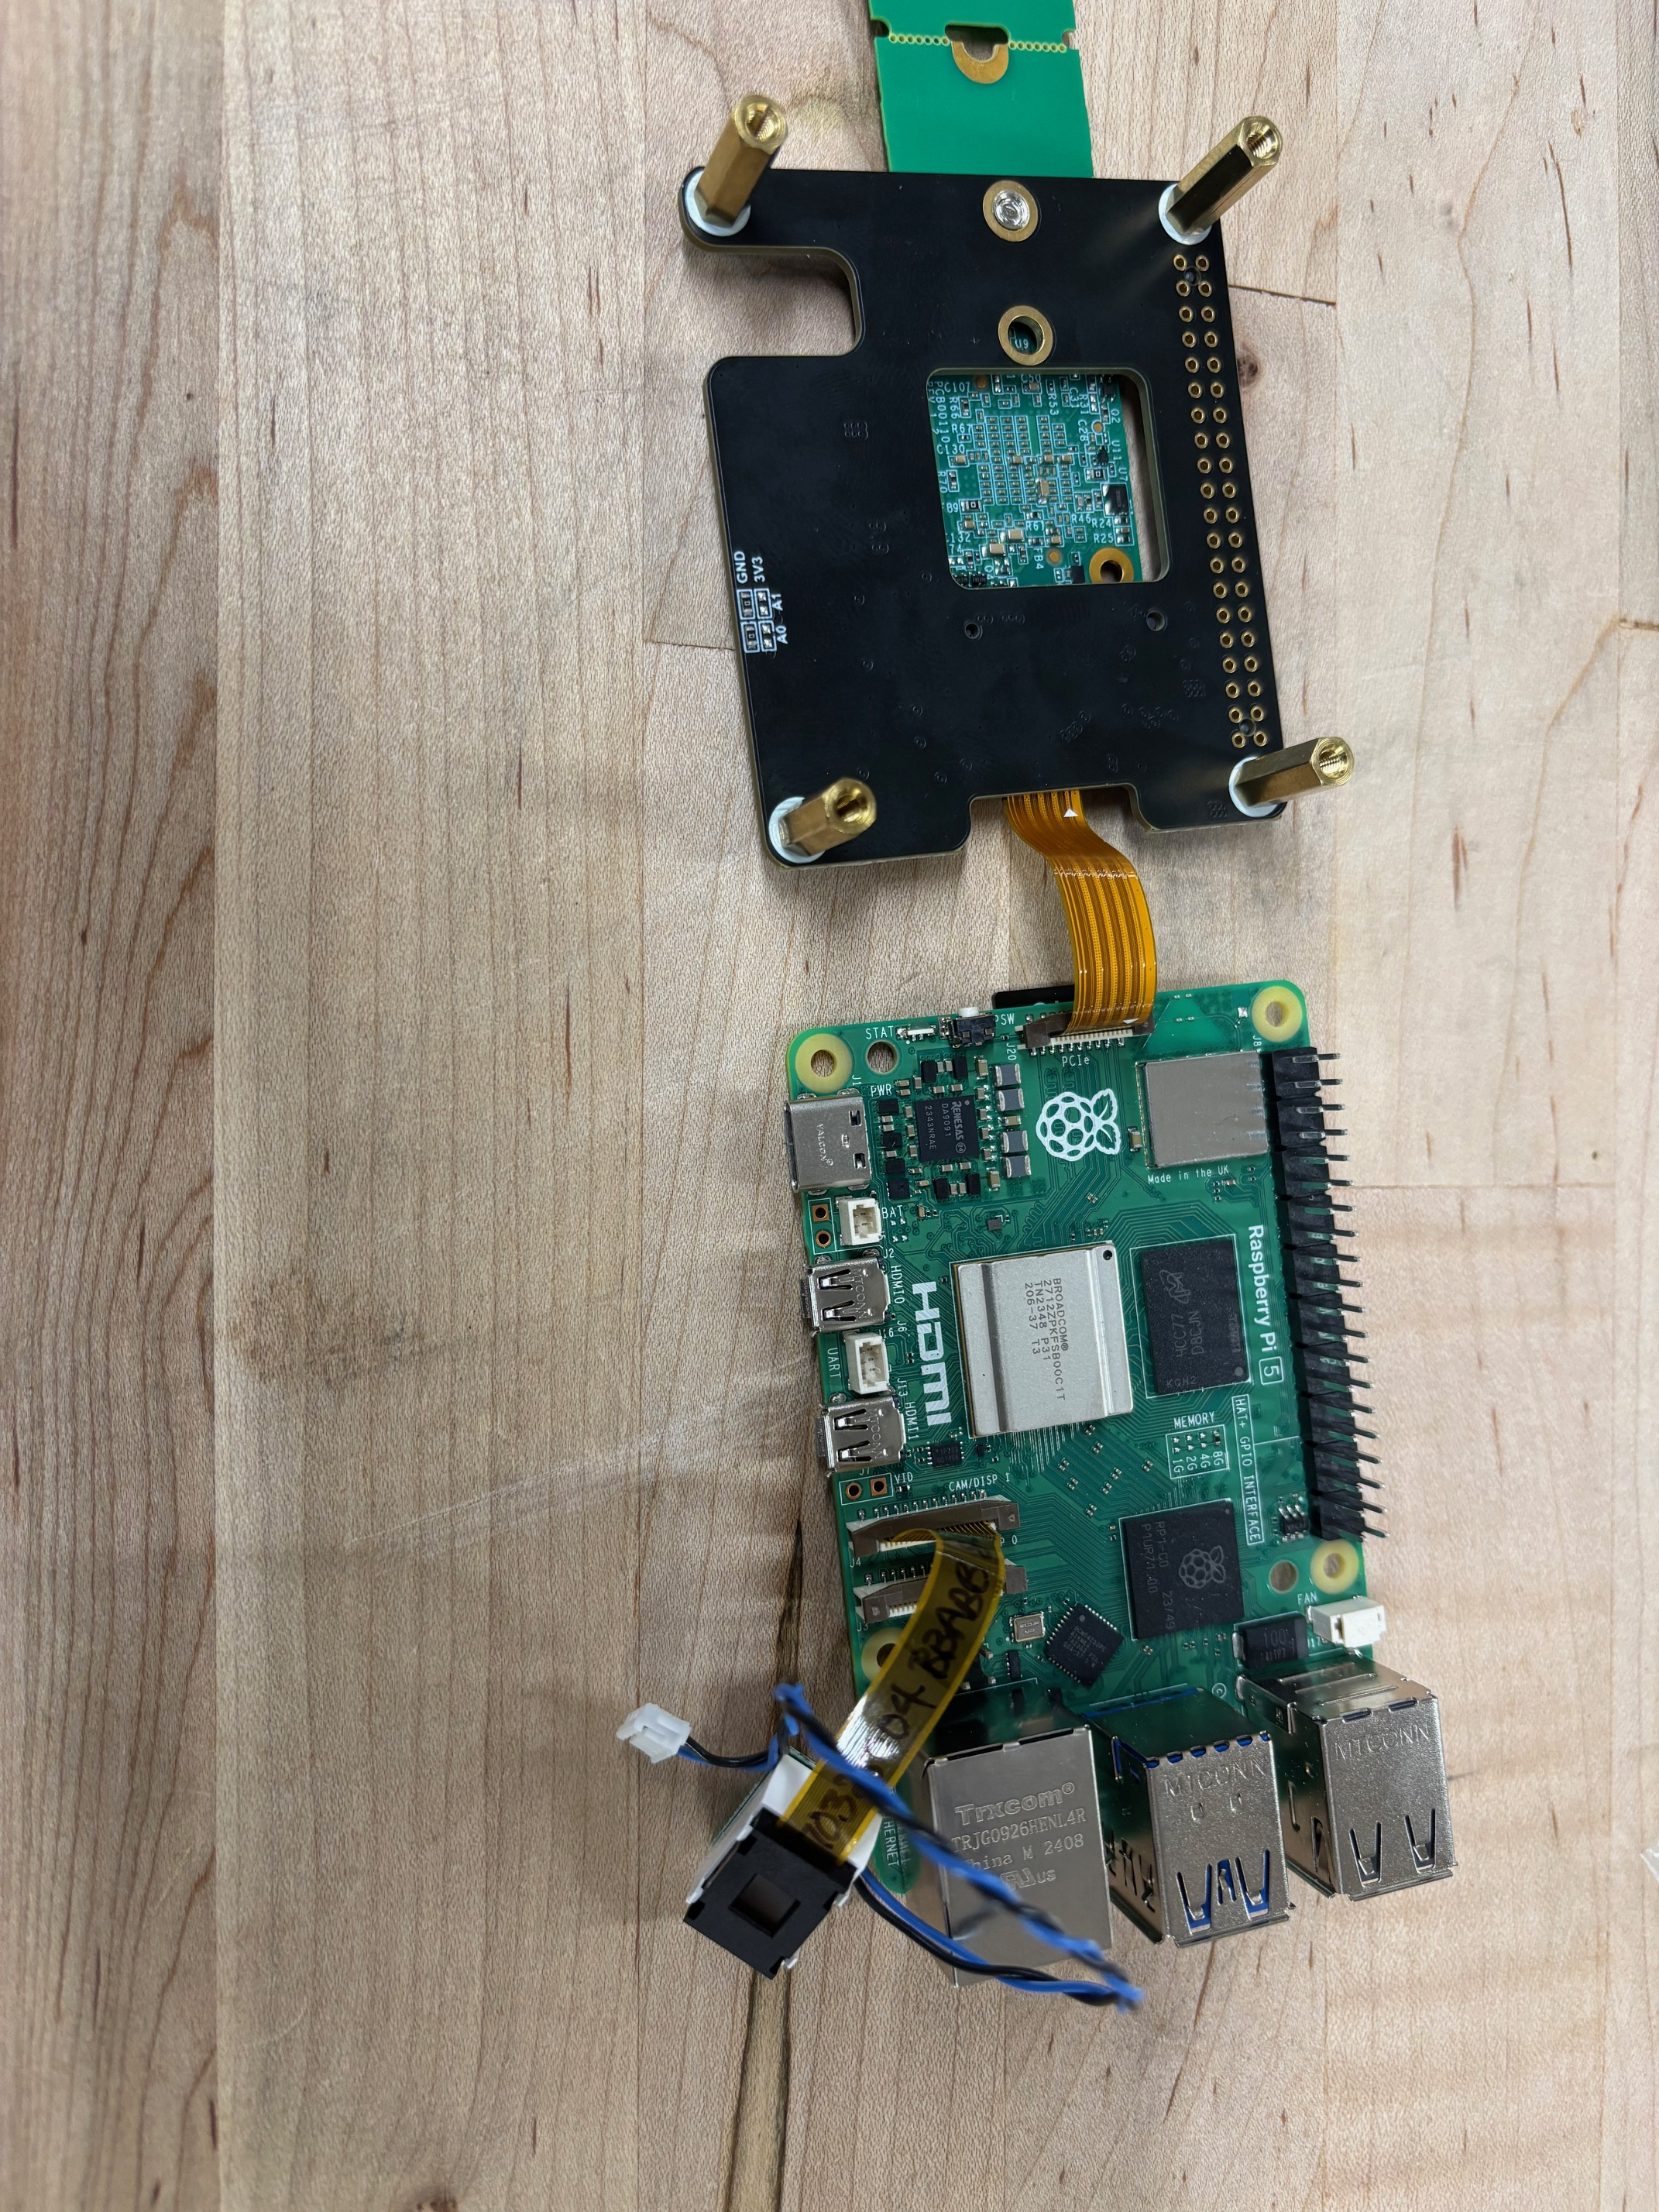
Building the Model
Begin by loading the training, testing, and validation datasets
Look for in-balance in data, then assign weights to each class
Train using the MobileNetV2 base model with data augmentation, then fine-tuning of selected layers to improve performance
Evaluate based off validation and training datasets then convert to TensorFlow Lite for deployment on a Raspberry Pi.

Slide 6
Challenges
Normalization of image data before training
Hardware setup for Raspberry Pi
Data collection and organization

Slide 7
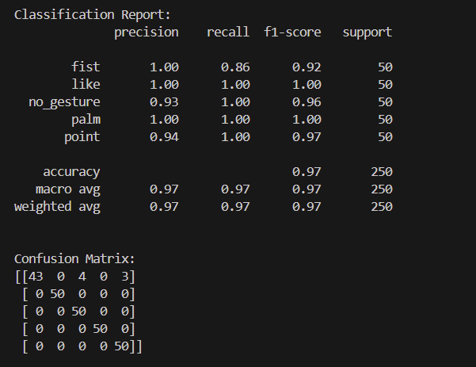
Results
Overall, the model accurately detected hand gestures
Some gestures more clear than others (fist least accurate)
Completes recognition within 0.05 seconds

Slide 8
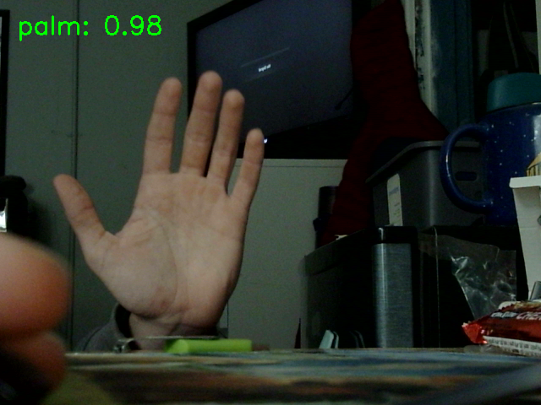
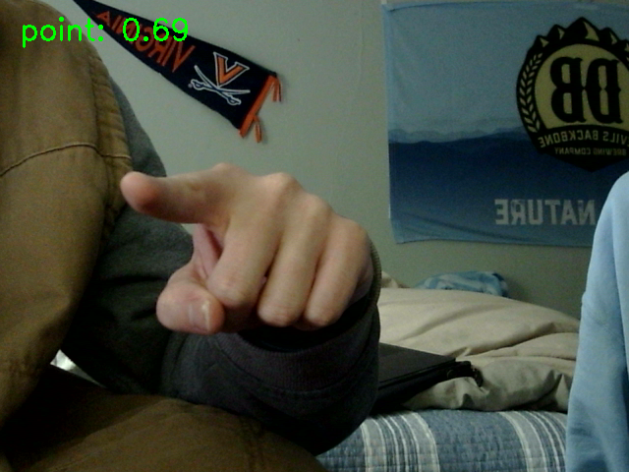
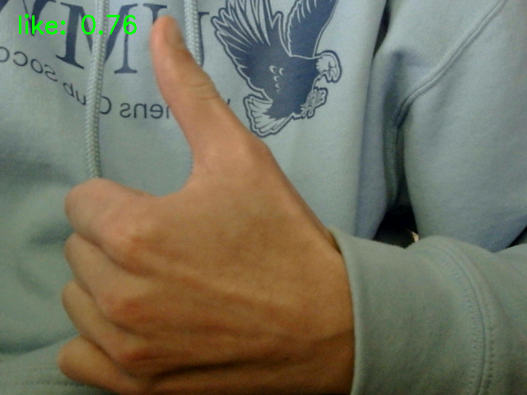
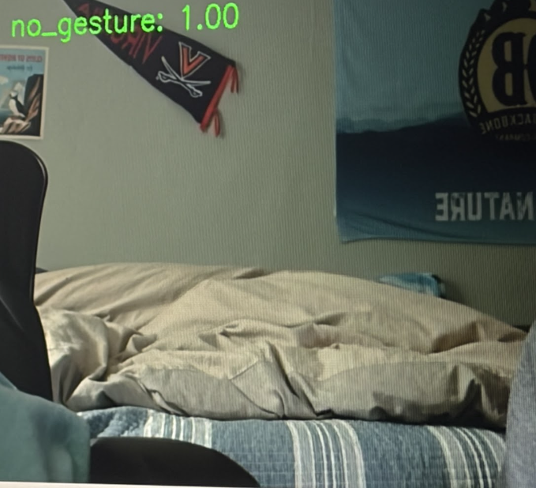
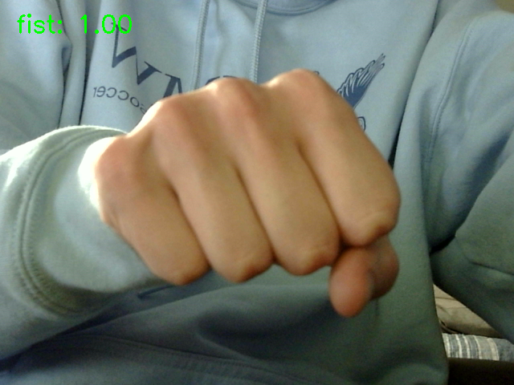

Slide 9
Limitations
Gesture needed to be certain distance from camera for accurate detection
Only tested with 2 people
Struggles when there is a lot of noise in the camera frame
Could be improved with data collection from more participants and various locations

Slide 10
Thank You

